Slide 1
J. 證明著色問題 (CHROMATIC COLORING PROBLEM)為NP問題。
106303536 謝崇煜 EE4B

Slide 2
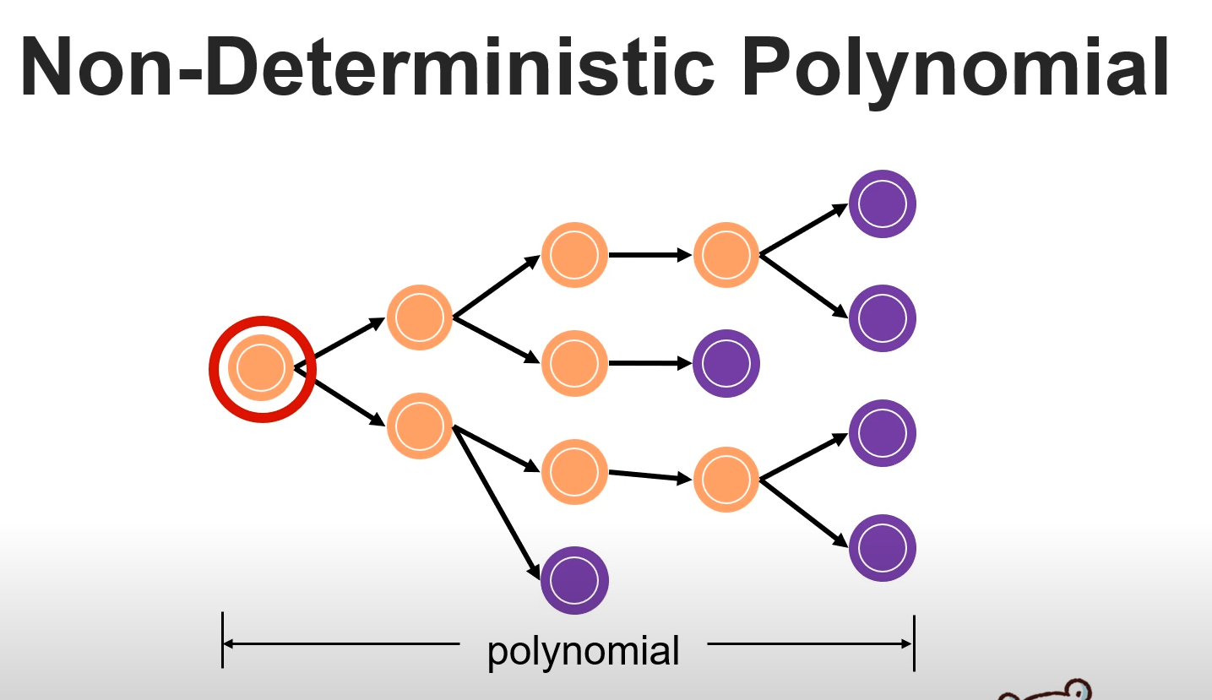
定義NP PROBLEM
1.”solved” in non-deterministic polynimal time
2.”verified” in polynimal time

Slide 3
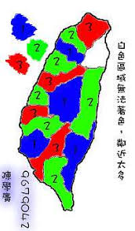
CHROMATIC COLORING PROBLEM
不失一般性 假設顏色數量K = 3
Graph G(V,E) 利用DFS概念去traversal
“for each edge{u,v} in graph G verify that the color c(u) != c(v)”
Verified time is polynimal time, takes O(V+E)

Slide 4
PROVE
chromatic coloring problem is ”verified” in polynimal time
Ans: chromatic coloring problem is NP Problem

